Slide 1
Shortest Path Problem
（最短路径问题）

Slide 2
Many problems in the real life are related to the shortest path problem. Such as
  Pipe lines
  Electric power grid
  Airline system
  Communicating network
*
School of Computer Science, BUPT
*

Slide 3
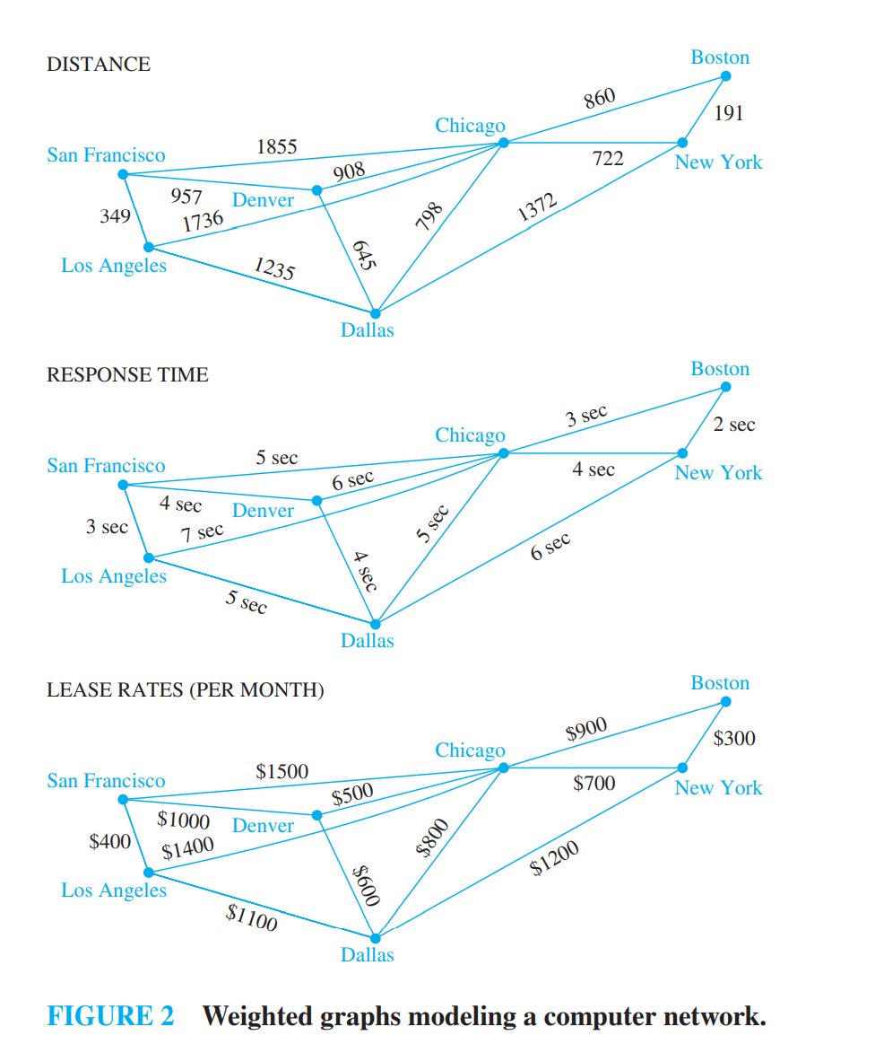
example
*
School of Computer Science, BUPT
*

Slide 4
Problem
There are two types of such problems
  Determining the shortest path from a vertex to an assigned vertex.
  Determining the shortest path of any two vertices in the graph.
*
School of Computer Science, BUPT
*

Slide 5
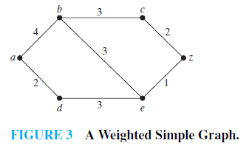
Example1
What is the length of a shortest path between a and z in the weighted graph shown in Figure 3?
*
School of Computer Science, BUPT
*

Slide 6
Dijkstra Algorithm
The algorithm is to find the shortest way from v₁ to v_{n},at the same time,it gets the shortest way from v₁ to each other vertices in the graph.
*
School of Computer Science, BUPT
*

Slide 7
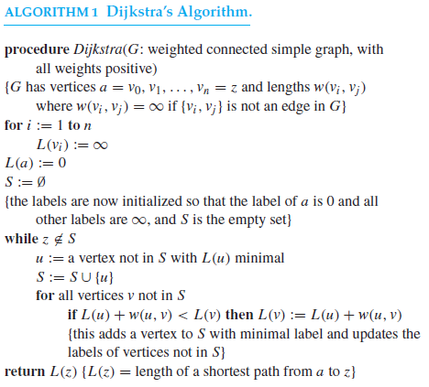
*
School of Computer Science, BUPT
*

Slide 8
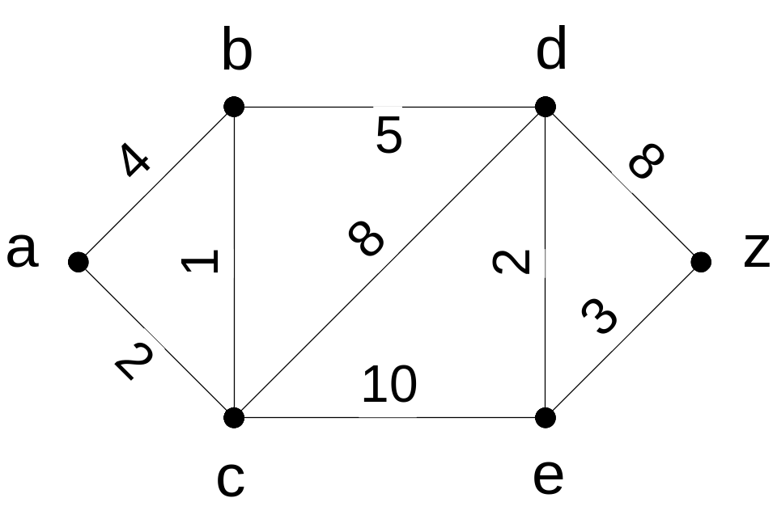
Dijkstra’s Algorithm -Example 2

Slide 9
Dijkstra’s Algorithm- Example 2
∞
4 (a)
∞
3 (a, c)
8 (a, c, b)
10 (a, c)
∞
16 (a, c, b, d)
0
13 (a, c, b, d, e)
∞
∞
10 (a, c, b, d)
2 (a)
12 (a, c)

Slide 10
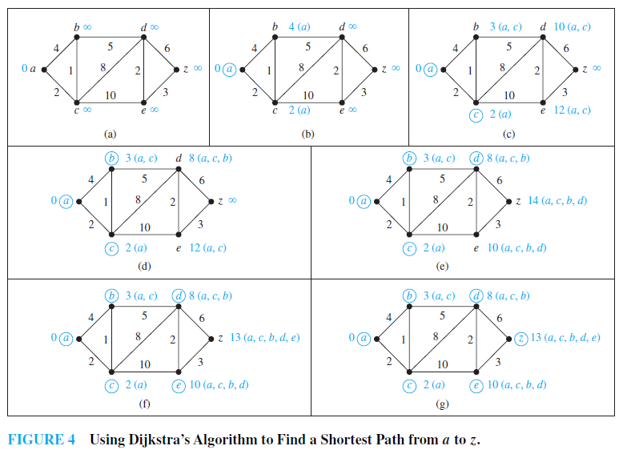
*
School of Computer Science, BUPT
*

Slide 11
Theorem 1
Dijkstra’s algorithm produces the length of a shortest path between two vertices a and z in an undirected connected weighted graph
  inductive hypothesis the following assertion:At the kth iteration
  (i ) ∀u∈ S ,L_{k}(u) is the length of a shortest path from a to u, and
  (ii ) ∀u∉ S, L_{k}(u) is the length of a shortest path from a to u contains only (besides the vertex itself) vertices in S
*
School of Computer Science, BUPT
*

Slide 12
When k = 0, S = ∅, so the length of a shortest path from a to a vertex other than a is ∞. Hence, the basis case is true.
Assume that the inductive hypothesis holds for the kth iteration.
Let v ∈ S at the (k + 1)st iteration,
  From the inductive hypothesis the vertices in S before the (k + 1)st iteration are labeled with the length of a shortest path from a.
  Also, v must be labeled with the length of a shortest path to it from a.
    If this were not the case, at the end of the kth iteration there would be a path of length less than L_{k}(v) containing a vertex not in S.
    Let u be the first vertex not in S in such a path.
    There is a path with length less than L_{k}(v) from a to u containing only vertices of S.
    This contradicts the choice of v.
*
School of Computer Science, BUPT
*

Slide 13
Let u ∉ S after k + 1 iterations.
  A shortest path from a to u containing only elements of S either contains v or it does not.
    If it does not contain v, then by the inductive hypothesis its length is L_{k}(u).
    If it does contain v, then L(u) =L_{k}(v) + w(v, u). This shows that (ii) is true, because L_{k+1}(u) = min{L_{k}(u), L_{k}(v) + w(v, u)}.
*
School of Computer Science, BUPT
*

Slide 14
THEOREM 2
Dijkstra’s algorithm uses O(n²) operations (additions and comparisons) to find the length of a shortest path between two vertices in a connected simple undirected weighted graph with n vertices.
*

Slide 15
Finding the shortest path between any two vertices
Distance Matrix: Let G is a graph with n vertices. The distance matrix of G is D=(d_{ij})_{n×n}
  d_{ij} represent the the weights of the edge (v_{i},v_{j})
  If there’s no edge between v_{i} and v_{j} then d_{ij}=∝
  Let D²=D*D= (d_{ij}²)_{n×n}
  d_{ij}²=min{d_{i1}+d_{1j}, d_{i2}+d_{2j},…, d_{in}+d_{nj},}
    d_{ij}² is the shortest length of the path from v_{i} to v_{j} with two edges.
  As the same D^{k}=D^{k-1}*D= (d_{ij}^{k})_{n×n}
    d_{ij}^{k} is the shortest length of the path from v_{i} to v_{j} with k edges.
*
School of Computer Science, BUPT
*

Slide 16
Define ⊕
Let A= (a_{ij})_{n×n} , B= (b_{ij})_{n×n}
C=A ⊕ B = (c_{ij})_{n×n}
  c_{ij}=min(a_{ij}, b_{ij})
P=D ⊕ D² ⊕ D³ ⊕ … ⊕ D^{n}
  p_{ij} = (p_{ij})_{n×n}
  p_{ij} represent the shortest length from v_{i} to v_{j}
*
School of Computer Science, BUPT
*

Slide 17
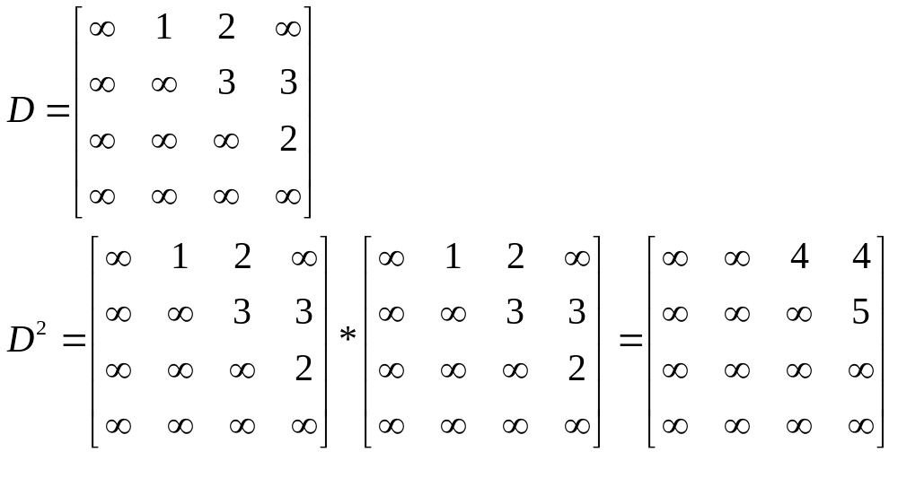
Example
1
3
3
2
2
*
School of Computer Science, BUPT
*

Slide 18
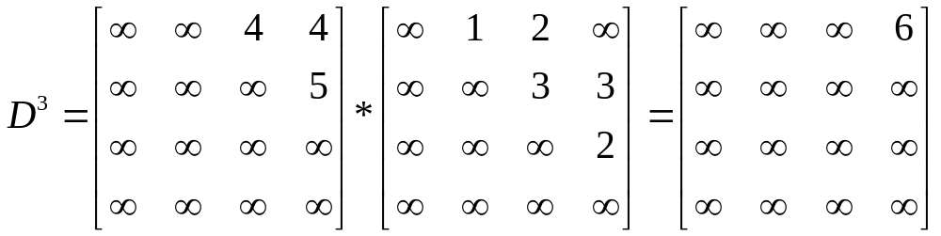
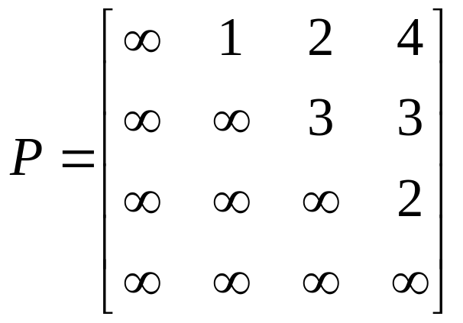
D₄=(∝) _{4×4}
P=D ⊕ D² ⊕ D³ ⊕D⁴
*
School of Computer Science, BUPT
*

Slide 19
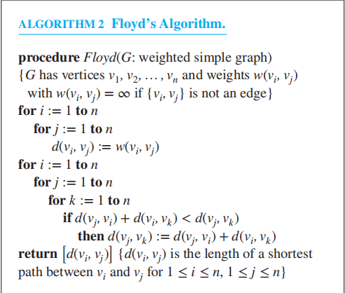
Floyd’s algorithm
*

Slide 20
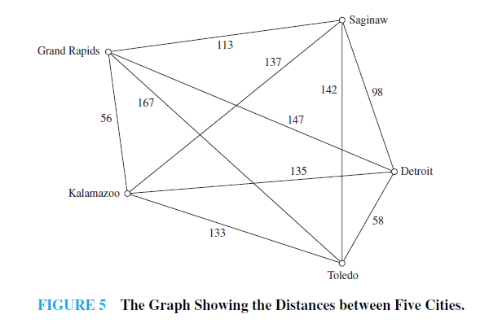
The traveling salesman problem
*
School of Computer Science, BUPT
*

Slide 21
homework
§10.6
  5（in exercise 2），21，
  Optional 16, 18, 26
*
School of Computer Science, BUPT
*

